Slide 1
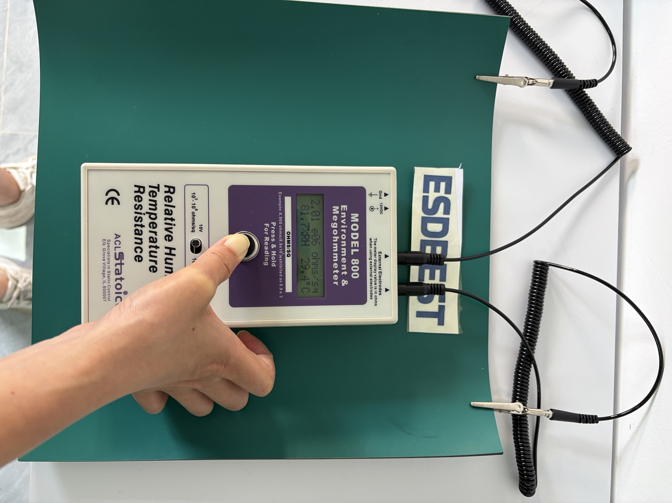
ESD Bench Mat Point-to-Point
Resistance Test Report
Two-Layer Electrical Resistance Verification Using ACL Model 800
Actual Test Data | ESDBEST
Sample: 25 × 30 cm • 2.0 mm • Two-layer rubber ESD bench mat
Method: Point-to-Point (PTP) • Test voltage: 10 V • Electrode spacing: 15 cm
Report ID: ESDBEST-PTP-907 Test date: 2026-7-20 Operator: Rachele

Slide 2
1. Test Objective & Sample
Actual PTP verification of the two electrical layers of an ESDBEST bench mat.
Test Objective
Sample Information
Layer Specifications
• Measure point-to-point (PTP) resistance at multiple locations
• Evaluate the green static-dissipative working surface separately from the black conductive bottom layer
• Record actual ACL Model 800 readings together with temperature and relative humidity
• Compare each layer only with its own specified resistance range
Product: ESDBEST Two-Layer Rubber ESD Bench Mat
Sample size: 25 × 30 cm (250 × 300 mm)
Thickness: 2.0 mm
Top layer: Green static-dissipative working surface
Bottom layer: Black conductive layer
TOP LAYER
1 × 10⁶ to 1 × 10⁹ Ω
BOTTOM LAYER
1 × 10⁴ to 1 × 10⁶ Ω
The two layers are evaluated independently.
Sample dimensions are recorded for traceability; layer-specific PTP resistance is the focus of this report.

Slide 3
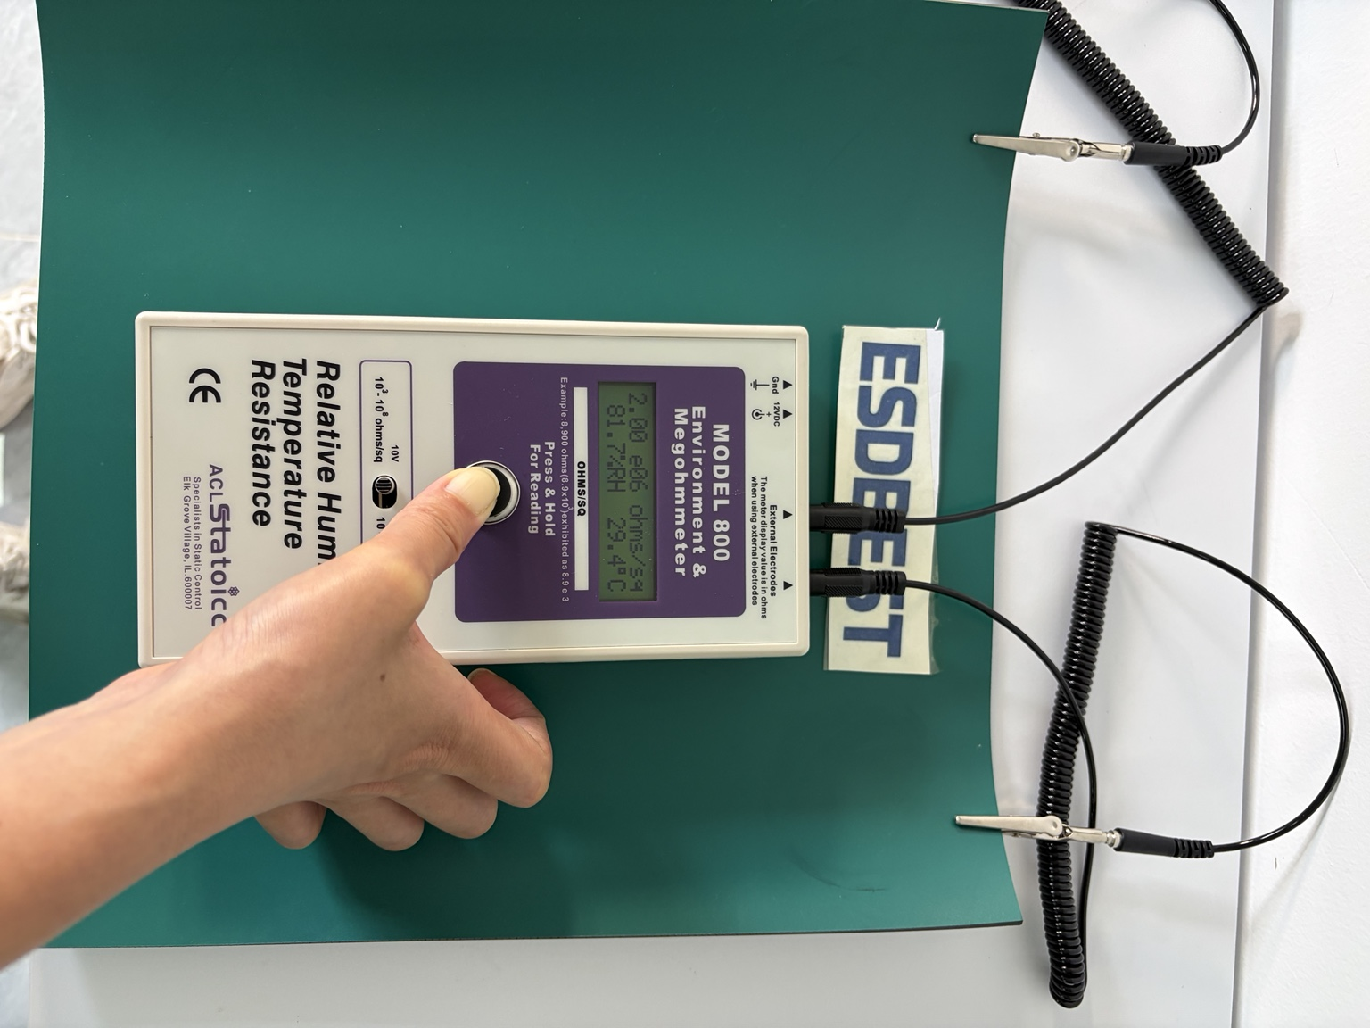
2. Test Equipment & Conditions
Parameters confirmed from the supplied test evidence and test record.
Test Instrument
ACL Staticide Model 800 Environment & Megohmmeter
Test Voltage
Electrode Spacing
10 V
15 cm (150 mm)
Temperature
Relative Humidity
29.2–29.4 °C
81.7–82.5 %RH
Electrodes: two external weighted resistance test electrodes. Test locations: multiple locations randomly selected across each test surface.

Slide 4
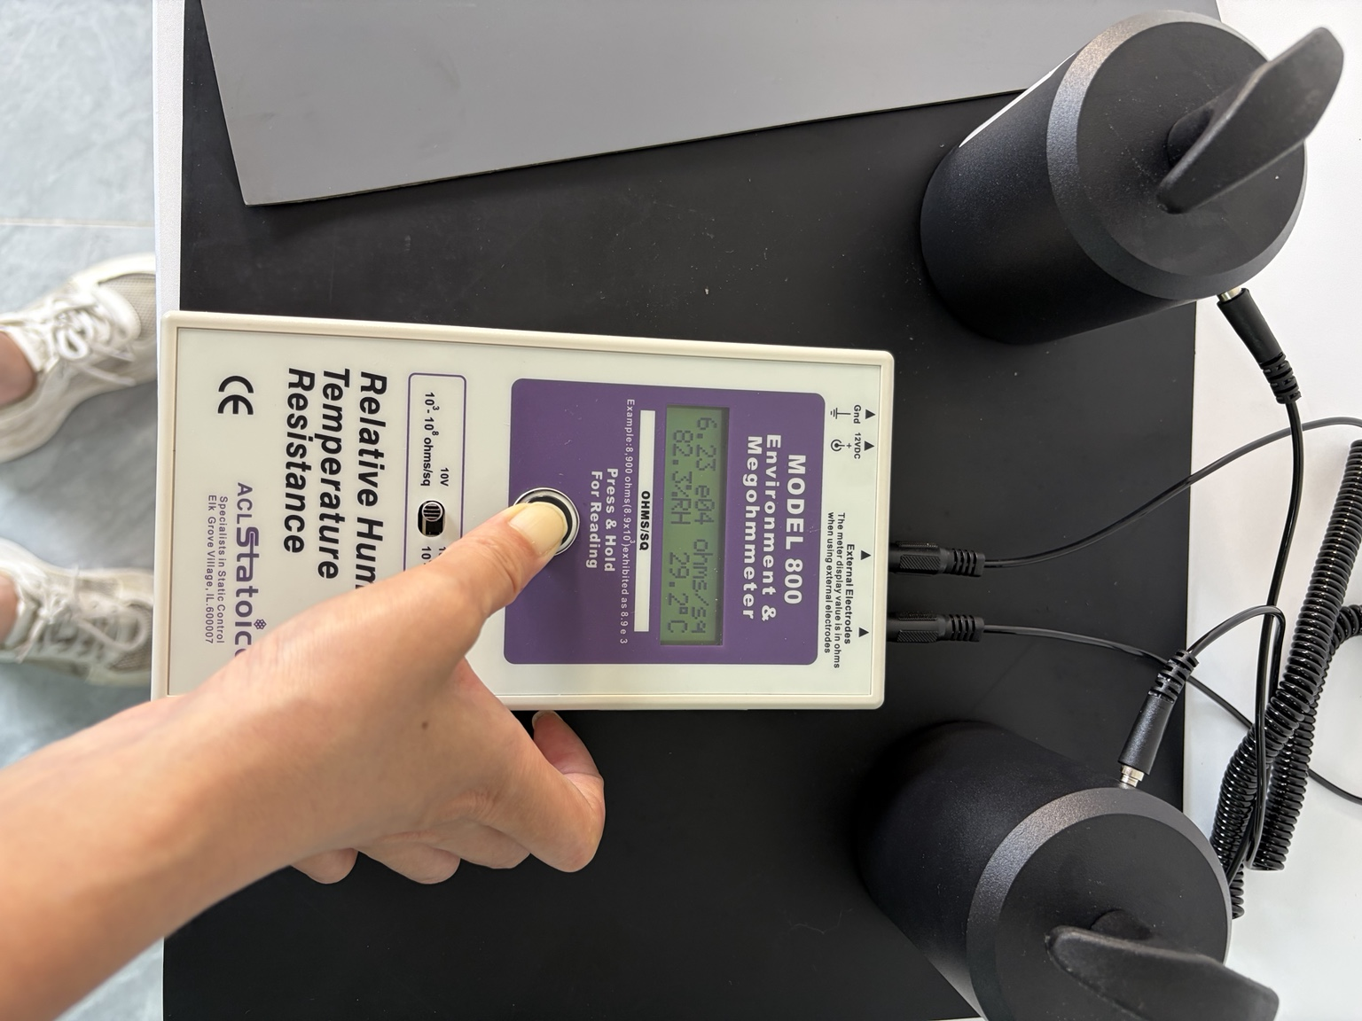
3. PTP Test Method
The green top layer and black bottom layer were tested separately.
Procedure
1. Place two weighted electrodes on the selected layer.
2. Maintain 15 cm (150 mm) electrode spacing.
3. Select 10 V on the ACL Model 800.
4. Record the stabilized PTP resistance reading.
5. Record temperature and relative humidity.
6. Repeat at randomly selected locations.
Test Locations
Green top layer: 2 randomly selected PTP locations
Black bottom layer: 6 randomly selected PTP locations
Total recorded measurements: 8
PTP readings are compared with the specification of the layer actually being measured—not with one universal resistance range.

Slide 5
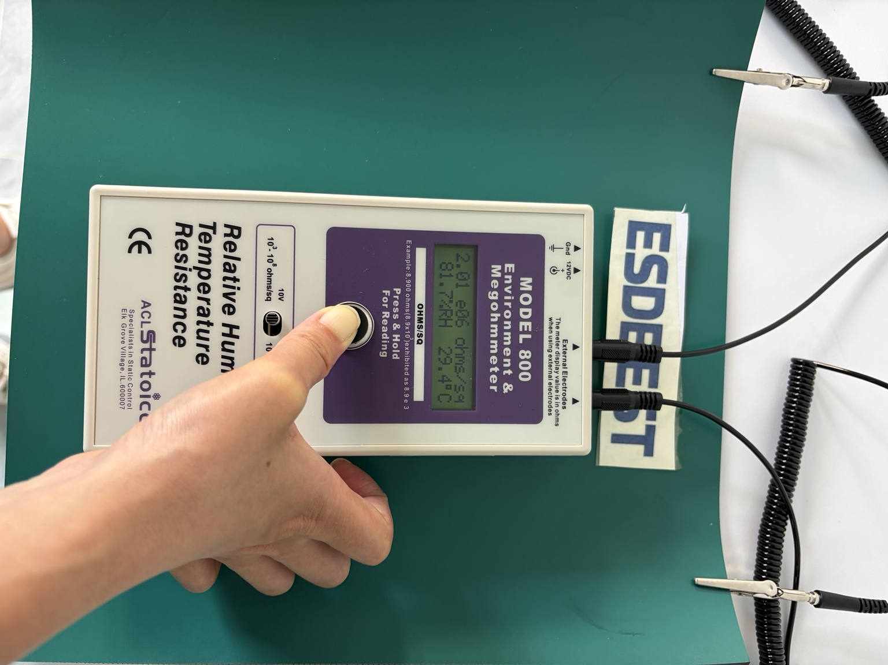
4. Green Top Layer — PTP Results
Static-dissipative working surface • Specification: 1 × 10⁶ to 1 × 10⁹ Ω
ID | Actual PTP Resistance | Specification | Result
PTP-T01 | 2.00 × 10⁶ Ω | 1 × 10⁶–1 × 10⁹ Ω | PASS
PTP-T02 | 2.01 × 10⁶ Ω | 1 × 10⁶–1 × 10⁹ Ω | PASS
2 / 2 PASS
Both recorded measurements fall within the specified static-dissipative working-surface range.
Observed green-layer PTP range: 2.00 × 10⁶ to 2.01 × 10⁶ Ω.

Slide 6
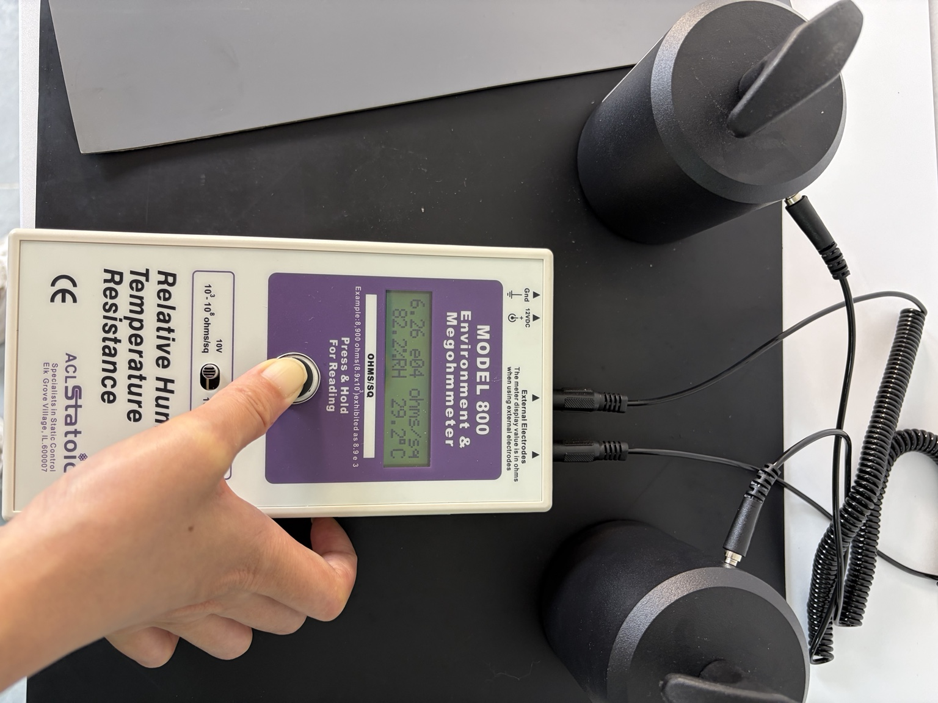
5. Black Bottom Layer — PTP Results
Conductive bottom layer • Specification: 1 × 10⁴ to 1 × 10⁶ Ω
ID | Actual PTP Resistance | Result
PTP-B01 | 5.76 × 10⁴ Ω | PASS
PTP-B02 | 3.12 × 10⁵ Ω | PASS
PTP-B03 | 3.12 × 10⁵ Ω | PASS
PTP-B04 | 6.23 × 10⁴ Ω | PASS
PTP-B05 | 6.26 × 10⁴ Ω | PASS
PTP-B06 | 3.50 × 10⁴ Ω | PASS
6 / 6 PASS
Observed range: 3.50 × 10⁴ to 3.12 × 10⁵ Ω
All six recorded bottom-layer measurements fall within the specified conductive-layer range of 1 × 10⁴ to 1 × 10⁶ Ω.

Slide 7
6. Two-Layer Verification Summary
The measured electrical behavior is consistent with the intended two-layer construction.
Green Working Surface
Black Bottom Layer
Function: Static-dissipative working surface
Specification: 1 × 10⁶–1 × 10⁹ Ω
Observed: 2.00 × 10⁶–2.01 × 10⁶ Ω
Result: 2 / 2 PASS
Function: Conductive bottom layer
Specification: 1 × 10⁴–1 × 10⁶ Ω
Observed: 3.50 × 10⁴–3.12 × 10⁵ Ω
Result: 6 / 6 PASS
8 / 8
recorded PTP measurements were within the specified resistance range for their respective layer.
Technical interpretation
The higher-resistance green surface and lower-resistance black bottom layer were evaluated separately. The result should not be described as “8/8 passed 10⁶–10⁹ Ω”; each layer has its own specified range.

Slide 8
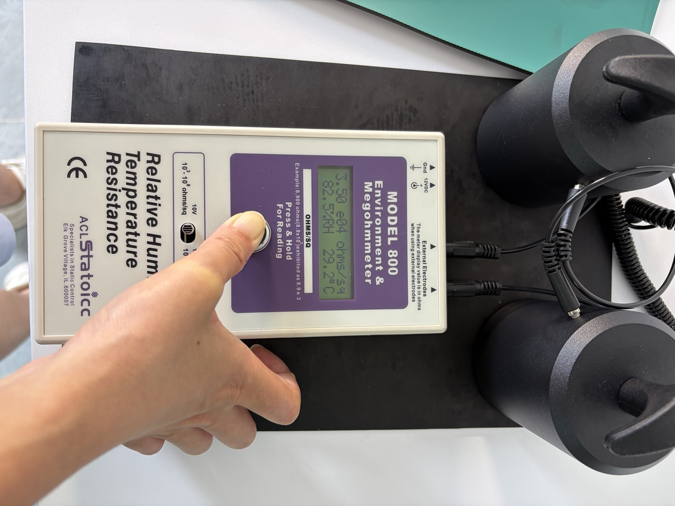
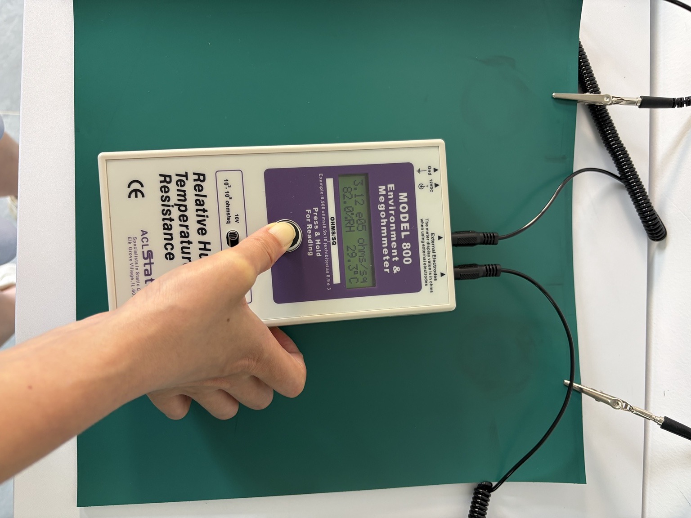
7. Photographic Evidence
Original test photos document the meter, electrode setup and layer-specific measurements.
Keep the original videos and photographs with the report package so editors or customers can trace published values back to the test evidence.

Slide 9
8. Conclusion & Sign-Off
Actual test data for the 25 × 30 cm, 2.0 mm two-layer ESD bench mat sample.
Technical Conclusion
Test Summary
The green static-dissipative working surface recorded PTP values of 2.00 × 10⁶ Ω and 2.01 × 10⁶ Ω, both within its specified 1 × 10⁶–1 × 10⁹ Ω range. The black conductive bottom layer recorded six PTP values from 3.50 × 10⁴ Ω to 3.12 × 10⁵ Ω, all within its specified 1 × 10⁴–1 × 10⁶ Ω range. All eight recorded measurements were within the specified range for their respective layer.
Method: PTP
Voltage: 10 V
Electrode spacing: 15 cm
Temperature: 29.2–29.4 °C
RH: 81.7–82.5%
Overall recorded result: 8 / 8 within specification
Approval
Tested by: Rachele Date: 2026-7-20 Reviewed by: Tony Date: 2026-7-23
Report ID: ESDBEST-PTP-907 Revision: Sherry
Results apply to the tested sample and documented conditions. Do not generalize these measurements to every production lot without corresponding QC records.

